Slide 1




The Every Student Succeeds Act
ESSA Opportunities at the Local Level
Local Progress
July 7, 2016

Slide 2
What issues does your school community care most about?
Standardized Testing?
Educator Empowerment?
Opportunity Dashboard?
Resource Equity?
Community Schools?
School Discipline?
Other?

Slide 3
Agenda
Leave with understanding of intent and key principles of the Every Student Succeeds Act
Discuss local decision making and organizing opportunities
Q&A

Slide 4
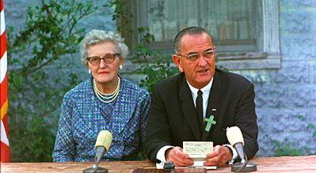
Johnson’s Great Society
Elementary and Secondary Education Act (1965)
Notes:
This is President Johnson’s 1st grade teacher. ESEA was meant to be a great educational equalizer. This is President Johnson’s 1st grade teacher. ESEA was meant to be a great educational equalizer. Miss Katie Deadrich taught eight grades in one room. “As a son of a tenant farmer, I know that education is the only valid passport from poverty. I believe deeply no law I have signed or will ever sign means more to the future of America. ” Instrumental in passing the law and attending the ceremony was Democratic Representative Carl Albert of Oklahoma (Little Giant from Little Dixie",)

Slide 5

ESSA Implementation = Opportunity
After nearly 14 years of asking for less federal intrusion into the teaching and learning process, it is finally here!
  Opportunity for educators to drive teaching and learning decisions to benefit students
  Opportunity to strengthen partnerships with parents, communities, to advocate for what students really need
  Must work together to defeat bad ideas and policies at the federal and state levels that do not benefit students

Slide 6
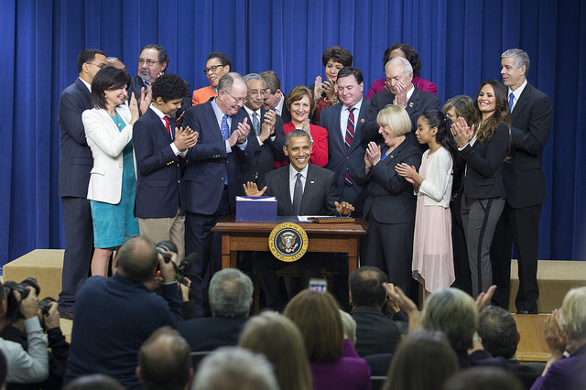
ESSA Represents Big, Bipartisan Legislative Success
House passes ESSA – 359 to 64!!!
Senate passes ESSA – 85 to 12!!!!
Now it is onto the states and locals….

Slide 7

Where have we been? NCLB
NCLB circa 2002 increased the federal test requirements to 17
Required the one-size-fits-all AYP
Caused massive over-identification of schools across the country
US Dept of Ed created a patchwork of waiver relief
  Required the school improvement models and teacher evaluation systems based on state tests.
Notes:
Before we talk in depth about the opportunities connected to this new statute, let’s take a moment to remember the context we’ve had to deal with the last few years.
*When the Elementary and Secondary Education Act of 1965 was last reauthorized in 2002, it became known as the No Child Left Behind law. The Every Student Succeeds Act of 2015 now replaces NCLB.

Slide 8
What were the best and worst things about NCLB??
Notes:
Popcorn and share out.

Slide 9
Every Student Succeeds Act
What’s gone?
  AYP is gone! No more 100-ways-to-fail!
  Federal punitive labels for schools are gone!
  Rigid, non-research based interventions are gone!
  No more Race to the Top, federally required teacher evaluations, based on standardized test scores!
  Accountability systems based solely on standardized tests are gone!

Slide 10
Every Student Succeeds Act
What concepts remain in new law?
High Standards: Every state must have college and career ready standards
  Statewide Assessments: Maintains testing in grades 3 – 8, once in HS for math and ELA, gradespan for science…. BUT
  Promotes state and local audits to eliminate duplicative or unnecessary tests
  New option for HS assessments
  New flexibility to create assessment systems that don’t rely on statewide standardized tests
Disaggregation: States still required to look at data from subgroups, so groups of students don’t fall through cracks
Interventions: Required for low-performing schools, but no rigid federally prescribed list; must be evidence-based

Slide 11
What’s different about accountability?
State accountability can’t be based solely on tests!
Systems must include:
  Math, reading assessments
  Another statewide indicator for middle and elementary schools
  Graduation rates
  English Language Proficiency
  Not less than one indicator of school quality or student success (i.e., from NEA Opportunity Dashboard!)
  *95% participation rate remains, but states now decide impact
  aggregate of #i - #iv must count for ‘much greater weight’ than #v
Notes:
**The 95% participation rate mandate still remains, but states now get to decide the impact under ESSA (under NCLB, the consequences were prescribed)

Slide 12
What about school improvement?
States will have to create a system to identify 2 types of schools:
  Subgroup schools – identify schools that have consistently underperforming subgroups
    Differentiation based on all indicators
    Districts create the school improvement plan – must make progress in district-defined # of years
  Lowest performing schools – identify bottom 5% of Title I schools, add high schools with lower than 67% grad rates and lowest subgroup schools
    Must do a resource equity plan, district develops improvement plan
    Improve within 4 years or state needs to do more

Slide 13
What’s different about accountability?
V. Indicators of school quality or student success
Not less than one of the following:
1. Student engagement
2. Educator engagement
3. Student access to and completion of advanced coursework
4. Postsecondary readiness
5. School climate and safety
6. Any other indicator that meets the requirements under (v)(I)

Slide 14


Recognize the indicators?
The Opportunity Dashboard

Slide 15
Indicators in the accountability system
Which one(s) do you pick???
1. Student engagement
2. Educator engagement
3. Student access to and completion of advanced coursework
4. Postsecondary readiness
5. School climate and safety
6. Any other indicator that meets the requirements under (v)(I)
You are not limited to the ones listed here

Slide 16
Selection
How to determine which indicators to pick
The Three-Point Plan!!
  First, you need to have an ESSA Implementation team!
      Team members should include locals and partners
        civil rights organizations
        disability rights organizations
        Parents (PTA, PTO)
        community members
  Second, convene your ESSA Implementation team and conduct an opportunity audit
  Finally, present your indicator preferences to the state education agency and state legislators (be prepared to prove your indicators can be measured and are integral to student success!)

Slide 17



Opportunity Audit
What is it?
nea.org/gpsindicators

Slide 18



Opportunity Audits
Many uses!!

Slide 19
Table Discussion
    What makes a great public school?
    What policies and practices do we need to implement to achieve a great public school?
    Which indicators would make the most difference in student learning?
Notes:
30 minutes.

Slide 20
5 Steps to Creating Your Local’s ESSA Team
1. Inform and engage your community
  Reach out with information and resources
2. Recruit leaders to join Local ESSA Team
3. Identify and invite new leaders to participate in your Local’s ESSA Team with special focus on
  early career educators
  diversity (ethnic, racial, grade, subject area, etc.)
  parents
  community organizations

Slide 21
5 Steps to Creating Your Local’s ESSA Team
4. Convene Your Local ESSA Team and:
  Determine priority issue interests
  Identify other community allies to partner with
5. Claim your ESSA Implementation Space
Pass ESSA School Board Resolution
Host ESSA Community Briefing with information and resources (from NEA policy experts or others)
Conduct a scan of “stakeholders”
Request an assessment and/or opportunity audit

Slide 22

Partner talk:
What does meaningful stakeholder engagement ON ESSA look like?
Notes:
What does meaningful sa

Slide 23


Building Alliances, Partner Base
Build a broad base of support among allies and partners for implementation (for example, the local union, PTAs, PTOs, family engagement organizations, civil rights organizations, disability rights groups)
Remember to work collaboratively toward common goals
Ensure key stakeholders are represented

Slide 24

Other notable improvements:
NEW, positive language about Restorative Justice; ending the school-to-prison pipeline
Continued, but greater clarity around Opt Out options for students
Improvements to charter school transparency and accountability

Slide 25
Local District Actions
Don’t wait until the state and local education plans are finalized.
Be proactive!
Participate in your state’s development of the state plans. Stay informed of their positions and progress.
2. At each underperforming school, identify members to serve on the school-level committee that will design the school improvement plan and submit it to the district for approval.
  Consider:
  - Use the NEA Guide to Educator-Led School Improvement and the GPS Indicators Framework.
  - Don’t wait for the state notification. In schools you already know will be identified for comprehensive or targeted improvement, set up the collaborative committees as soon as possible, and begin the needs assessment.

Slide 26
Local District Actions
Don’t wait until the state and local education plans are finalized.
Be proactive!
3. Opportunity Audits
4. Reduce district assessments now
5. ESSA school board resolution
6. Initiate local implementation team

Slide 27
Local District Actions
New draft regulations of ESSA were issued by the U.S. Department of Education in May.
School board members, educators, parents, and other community members have until August 1 to make our serious concerns heard and make sure this new law becomes the game changer it promised to be.
We need you to urge the Department of Education to promote equity and to not exclude educator and community voices. Our students deserve better!
www.getESSAright.org

Slide 28

The Every Student Succeeds Act
Q & A

Slide 29
The Every Student Succeeds Act
OPPORTUNITY AWAITS!
FIND OUT MORE:
www.nea.org/ESSAbegins

Slide 30
Resources
www.nea.org/essabegins
Community Schools Federal Funding http://www.communityschools.org/policy_advocacy/federal_funding.aspx
www.getESSAright.org
Network for Public Education- Dept of Ed Regulations

